Slide 1

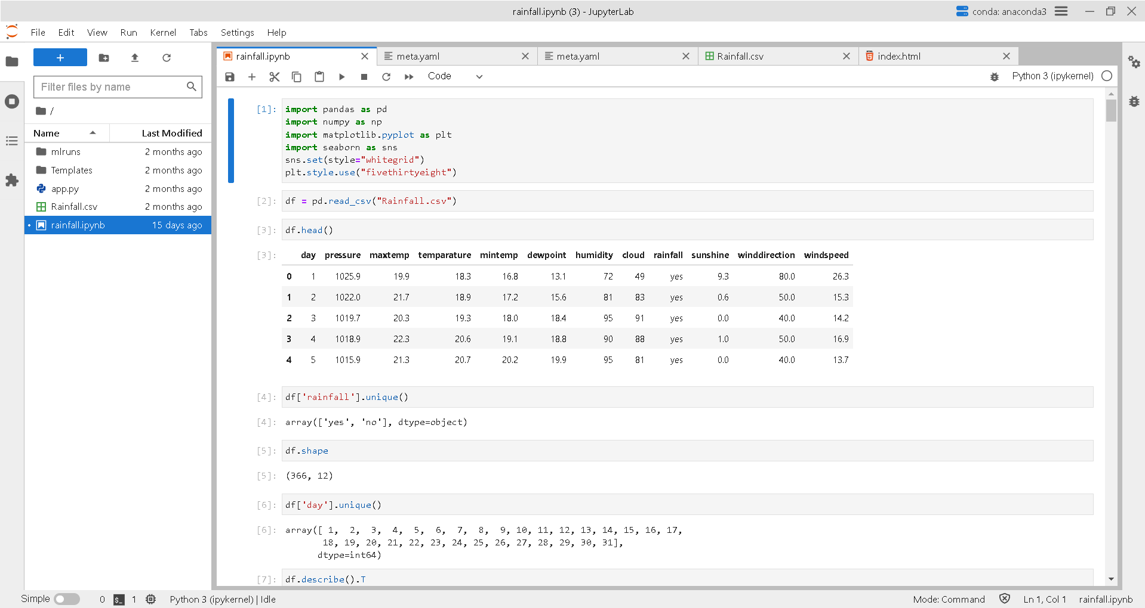
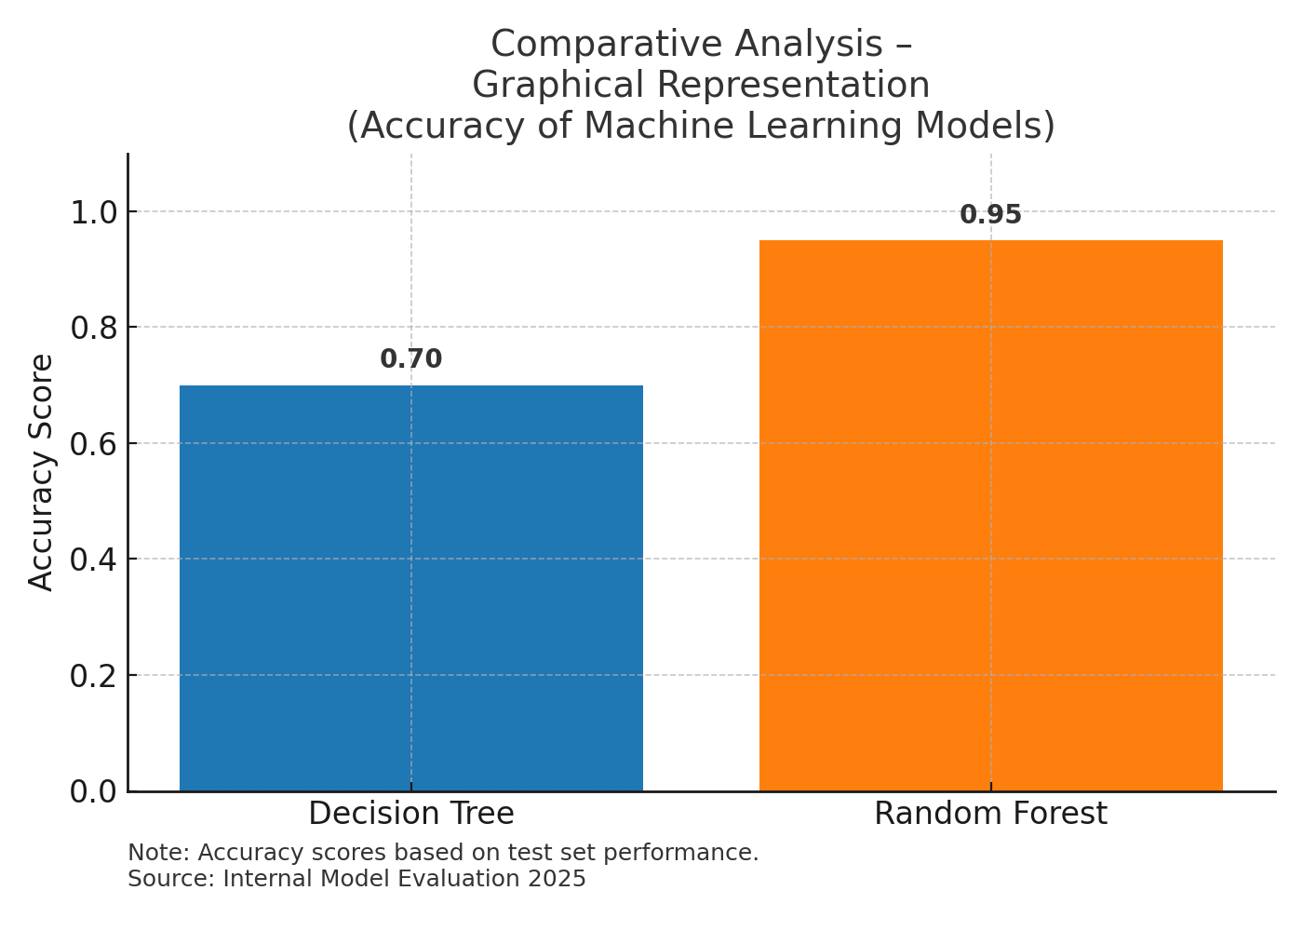
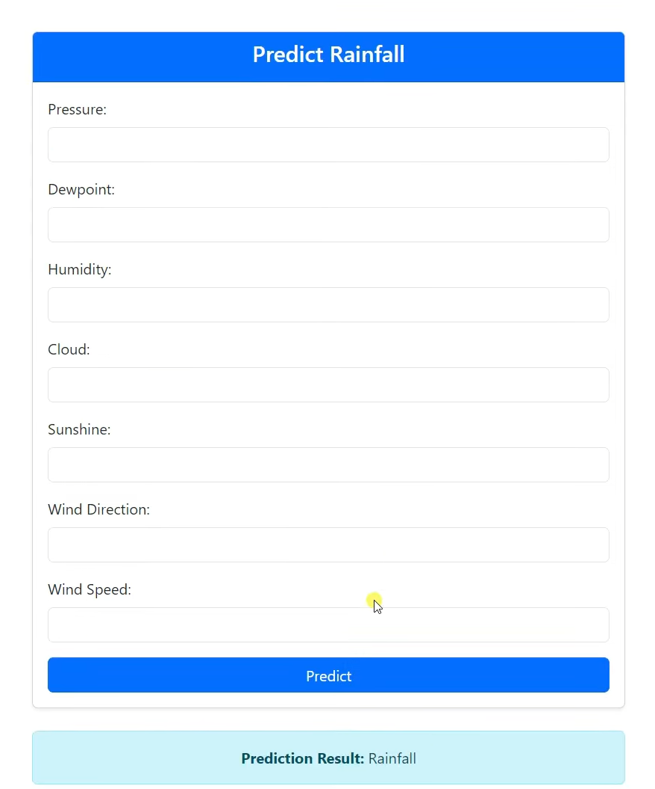
Machine Learning-Based Rainfall Forecasting for Precision Agriculture
Department of Computer Science and Engineering Batch: (2021-2025)
School of Computing
10214CS701-MAJOR PROJECT
INHOUSE
WINTER SEMESTER 2024-2025
ABSTRACT
INTRODUCTION
RESULTS
SUSTAINABLE DEVELOPMENT GOALS(SDG’s)
Accurate rainfall prediction is essential for precision agriculture, water resource planning, and disaster management. This project proposes a machine learning-based system that uses historical weather data (e.g., humidity, pressure, wind speed, cloud cover, dew point, sunshine duration) to predict rainfall. Models such as Random Forest and Linear Regression were trained using Python, with MLFlow managing experiment tracking and Flask enabling web-based real-time predictions. The system uses a clean data pipeline, enabling reproducible and optimized predictions. Visual analytics tools such as heatmaps and regression plots help validate model behavior. It is designed for scalability, accuracy, and usability, offering an effective tool for sustainable agricultural practices and climate-related decision-making.
Rainfall plays a crucial role in agricultural productivity, water conservation, and disaster preparedness. Traditional forecasting systems often fail to capture nonlinear interactions between atmospheric variables. This project leverages machine learning, supported by Scikit-learn and other Python libraries, to improve the accuracy of rainfall predictions. The methodology includes preprocessing, model selection, hyperparameter tuning, and deployment using Flask. The project also explores feature correlation using statistical techniques and integrates MLFlow for rigorous experiment tracking. This integrated pipeline bridges the gap between data science and real-world application, allowing timely and accessible rainfall forecasting through a web-based interface.
In addition, the project recognizes the increasing need for data-driven tools in climate-resilient agriculture. By employing a modular architecture, the system allows for easy adaptation to different geographies and data sources. It promotes automation, scalability, and ease of use enabling both researchers and local farmers to benefit from real-time, accurate rainfall insights. The broader goal is to support sustainable farming practices and minimize climate-related agricultural losses.
Random Forest outperformed Linear Regression in prediction accuracy. R² Score for Random Forest was 0.89 compared to 0.76 for Linear Regression, clearly indicating its ability to capture complex patterns. Additionally, Random Forest exhibited lower Mean Absolute Error (MAE) and Root Mean Square Error (RMSE), reflecting better prediction reliability. The system demonstrated consistent performance when validated on new, unseen data, showcasing its generalizability.
The Flask-based interface supports real-time predictions by allowing users to input weather parameters such as temperature, humidity, and wind speed. Output includes rainfall predictions as well as visual insights. Graphical representations used in the project include a correlation matrix heatmap, residual error plots, and a comparative accuracy chart. The user interface is designed to be responsive and can be extended to mobile platforms. A feature importance chart was also included to help interpret model behavior.
SDG 2 (Zero Hunger): Enables data-informed crop planning, enhancing food security and supporting smallholder farmers. Contributes to improved yield forecasting and irrigation schedules.
SDG 13 (Climate Action): Helps mitigate climate risks by offering accurate local rainfall forecasts and supporting early warning systems. Enhances adaptive capacity of agricultural systems.
SDG 9 (Industry, Innovation, and Infrastructure): Demonstrates how data and AI can modernize agriculture and environmental monitoring through robust backend systems and open-source software.
Impact: Reduces crop loss, optimizes irrigation, minimizes water and fertilizer waste, and contributes to resilient ecosystems. Enables digital transformation in agriculture using cost-effective tools.
Feature | Existing System | Proposed System
Model Type | Linear Models (ARIMA, Regression) | ML Models (Linear Regression, RF)
Accuracy | 75% | 89.2%
Real-Time Prediction | Not Supported | Fully Supported via Flask API
Experiment Tracking | Not Available | Integrated using MLFlow
User Interface | Typically Absent | HTMLWebForm(User-friendly)
Deployment | Local/Offline | Local + Cloud-ready
Scalability | Low | High
METHODOLOGIES
Data Collection: Historical weather data in CSV format sourced from publicly available meteorological databases including parameters like temperature, humidity, dew point, wind speed, cloud cover, and pressure. We also considered additional regional datasets to improve local accuracy.
Preprocessing: Includes missing value imputation, normalization, correlation analysis, and outlier handling. Exploratory Data Analysis (EDA) was used to identify important features. Visual tools such as scatter plots, boxplots, and heatmaps were used.
Modeling: Linear Regression and Random Forest were implemented. Random Forest was chosen for its ability to handle multicollinearity and nonlinear relationships. Hyperparameter tuning was performed using GridSearchCV. Performance was evaluated using R², MAE, and RMSE.
Experiment Tracking: MLFlow was used to track experiments, versions, parameters, and evaluation metrics. It ensured model reproducibility and improved collaboration across development stages. Each run included logs of training duration, validation scores, and model artifacts.
Deployment: The final model was deployed via a Flask web application, allowing user input of weather data and receiving predictions in real-time. HTML/CSS was used to design a simple and responsive UI that can also be adapted for mobile use.
Figure 2. Historical Data Set .
CONCLUSIONS
Table 1. Comparison Analysis Table.
The ML-based rainfall prediction system improves reliability and usability over traditional systems. It supports timely agricultural planning, reduces dependency on outdated forecasts, and fosters innovation in precision farming. By deploying the model online, farmers and planners can access real-time predictions from any location. The modular structure allows for easy integration with cloud APIs or regional datasets. This framework can be extended to include live API data, mobile platforms, and IoT sensor data for real-time environmental tracking.
TEAM MEMBER DETAILS
<Vtu19075/Nanda Venkata Subhash>
<Vtu19445/Shaik Muzakeer>
<Vtu20544/S. Murari Reddy>
<9440907982>
<8008091276>
<6300370328>
<vtu19075@veltech.edu.in>
< vtu19445@veltech.edu.in >
< vtu20544@veltech.edu.in >
ACKNOWLEDGEMENT
Project Supervisor Name : Dr. S. Durai, M.E., Ph.D.,
Project Supervisor Contact No : 9842845623
Project Supervisor Email : duraitrichy@gmail.com
Chart 1. Comparative Analysis Chart.
Figure 1. Output Design

